Slide 1
Md.Tanvir Hossain Saon
Roll: 388
Md.Abdullah Al Mamun
Roll:390
Saud Al Nahian
Roll:2149
Tenant Management
System

Slide 2
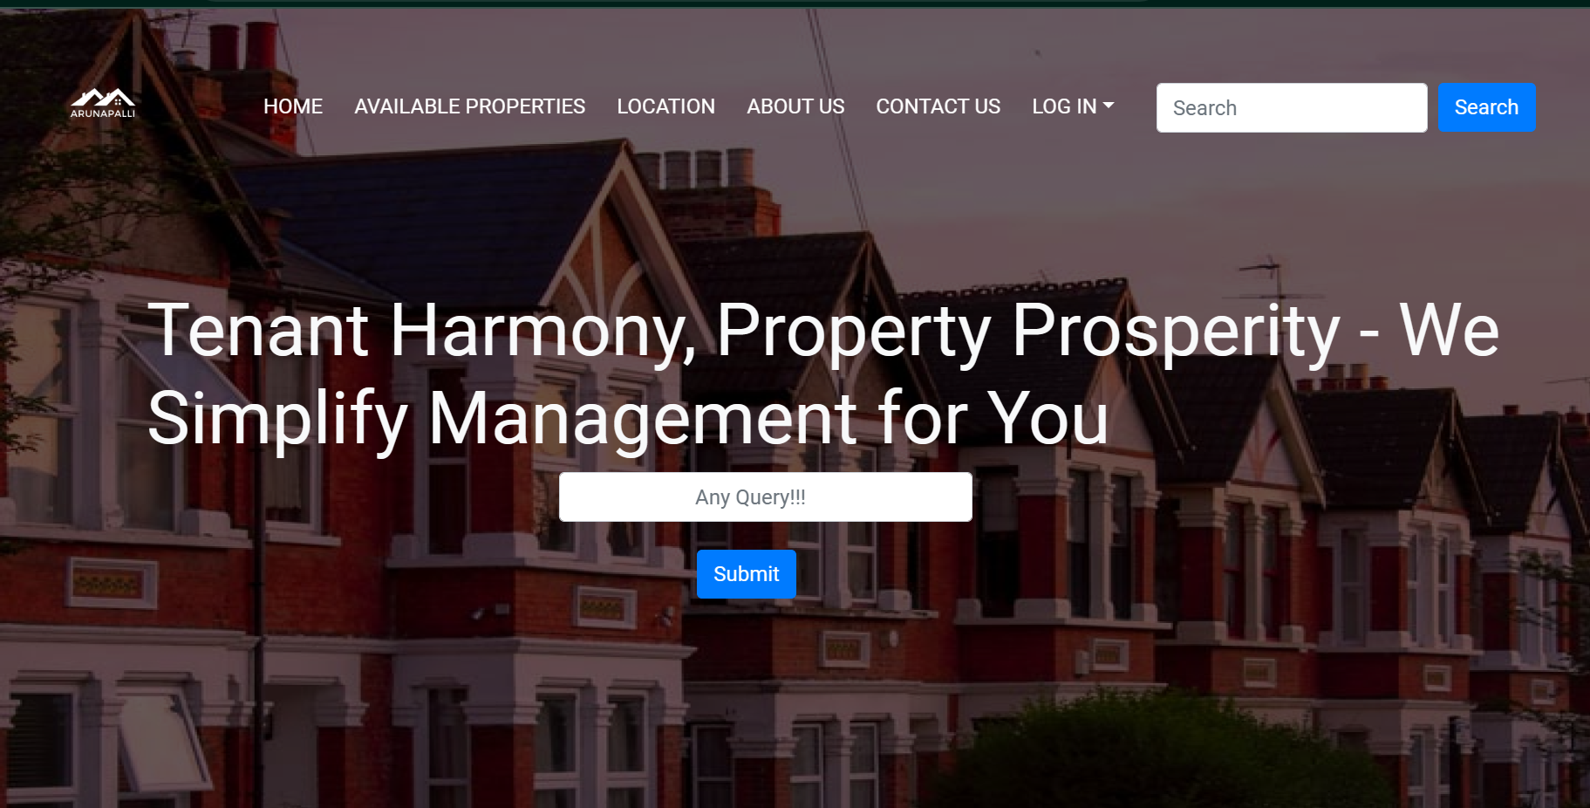
Home page

Slide 3
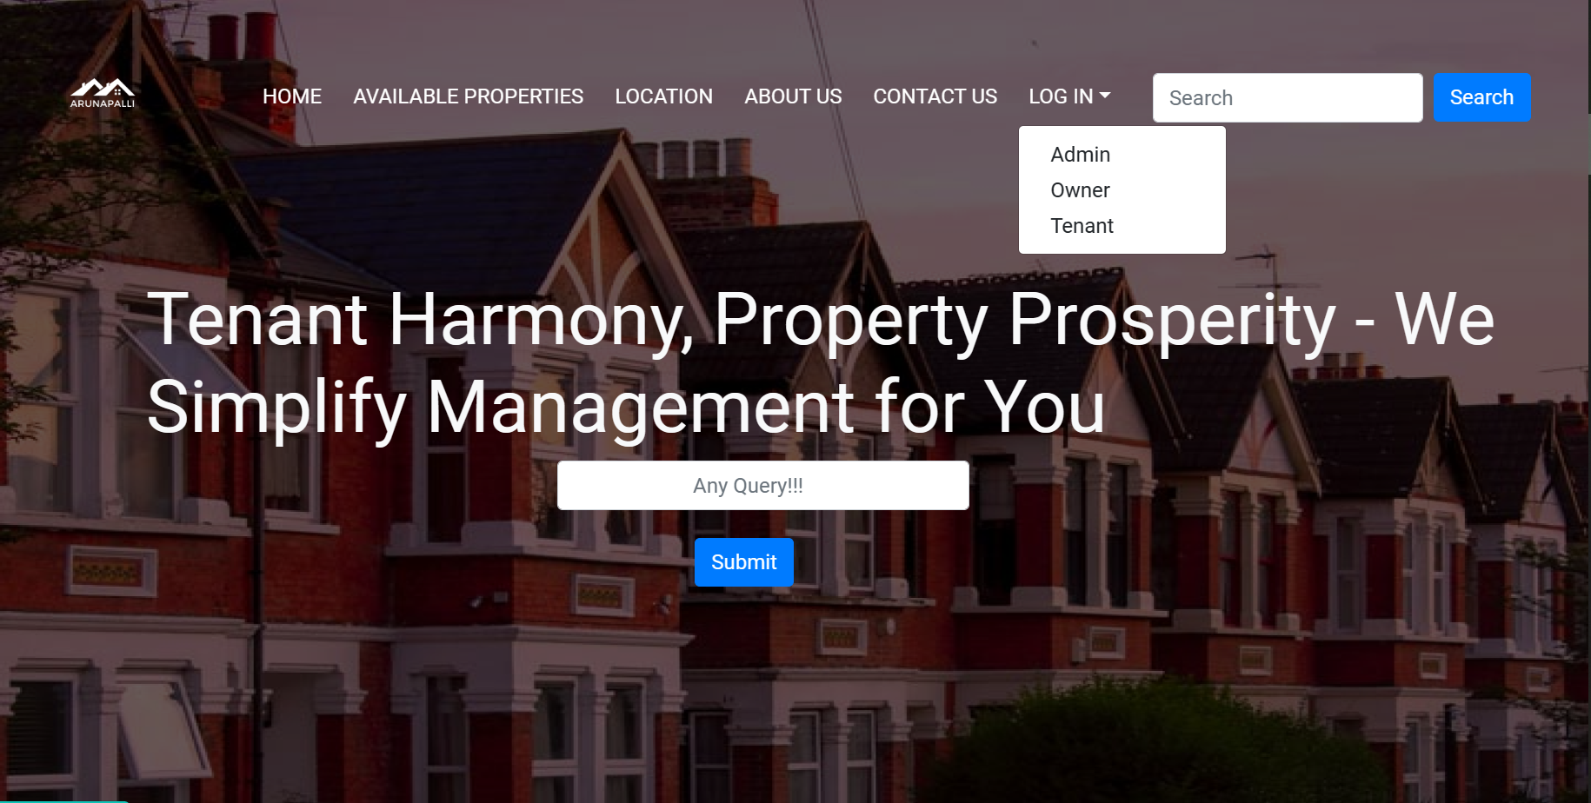
Log In

Slide 4
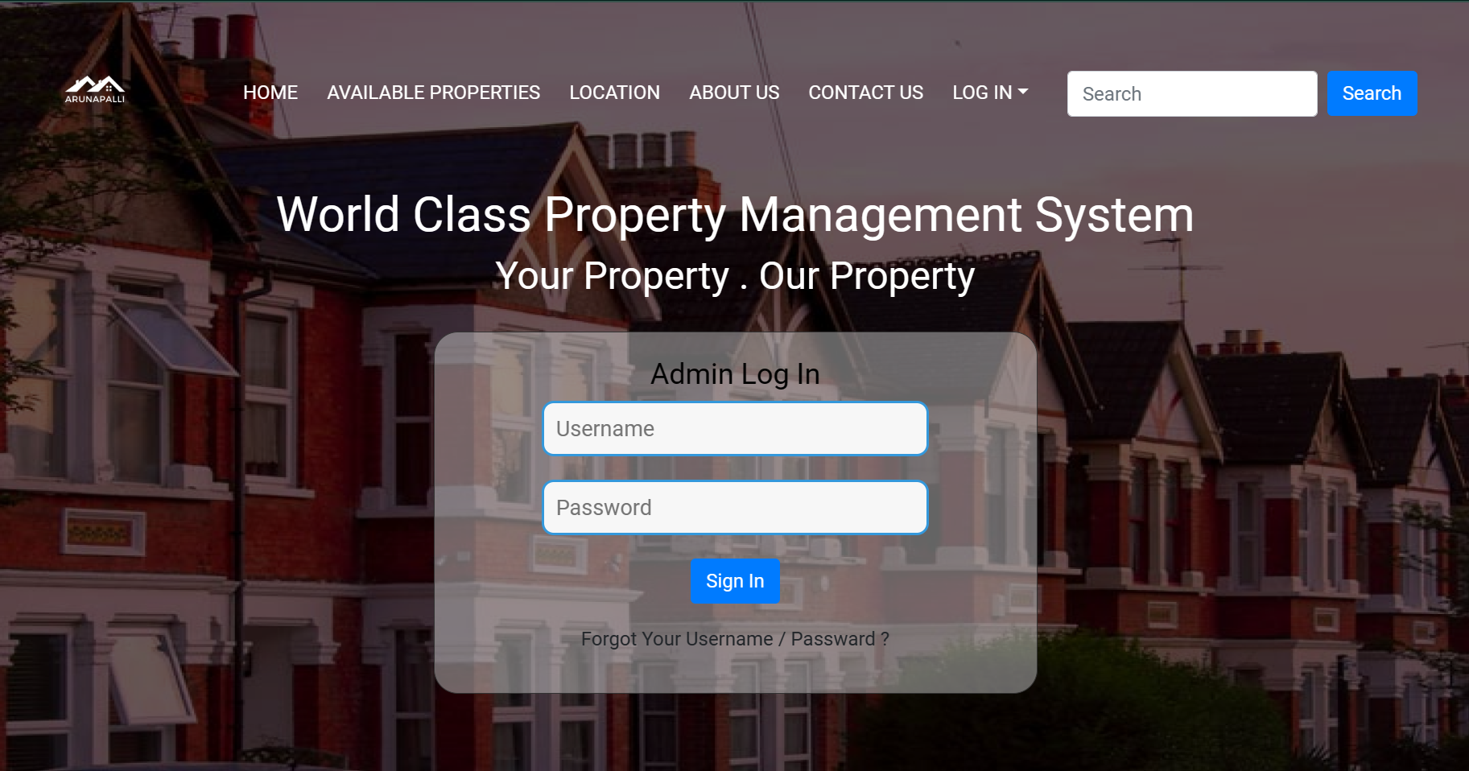
Admin Log in

Slide 5
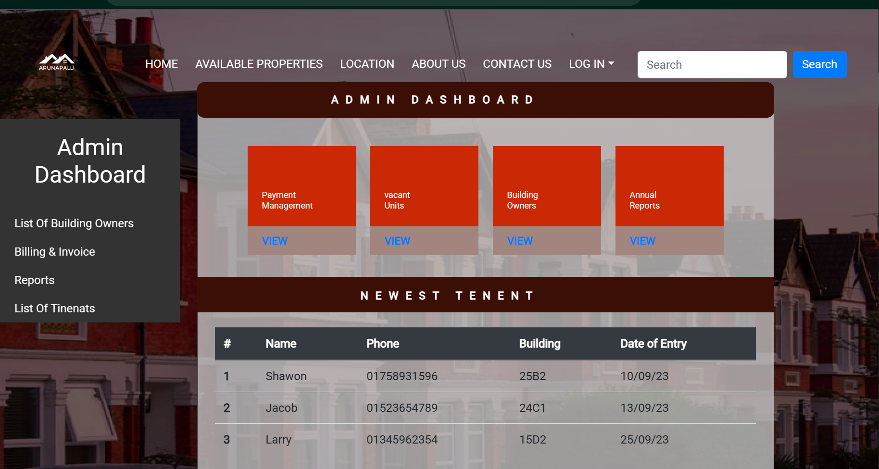
Admin Dashboard

Slide 6
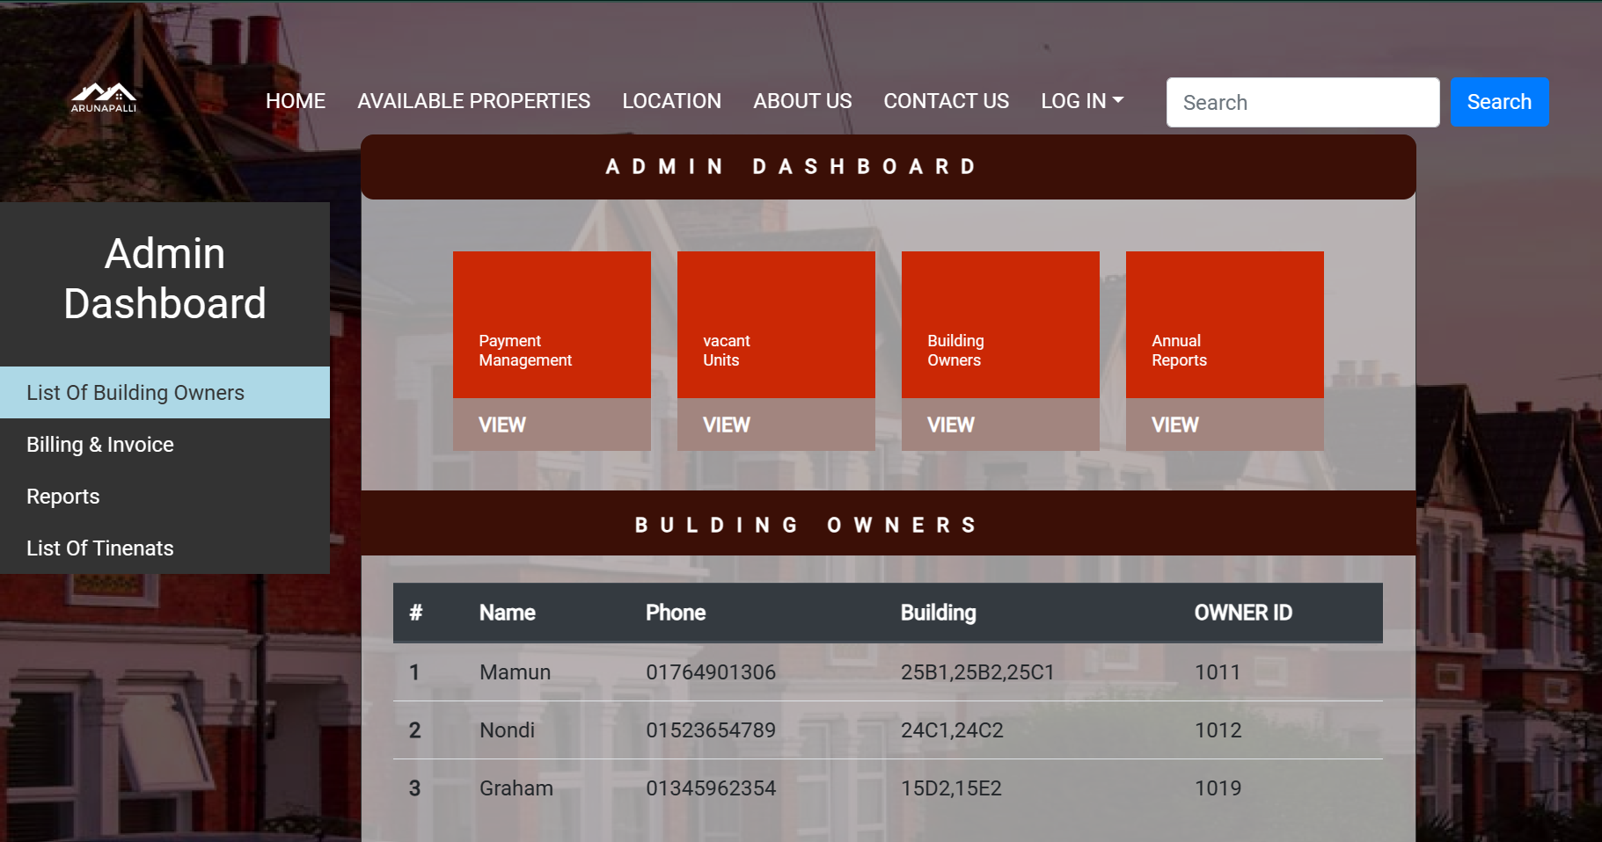
List of Landlords

Slide 7
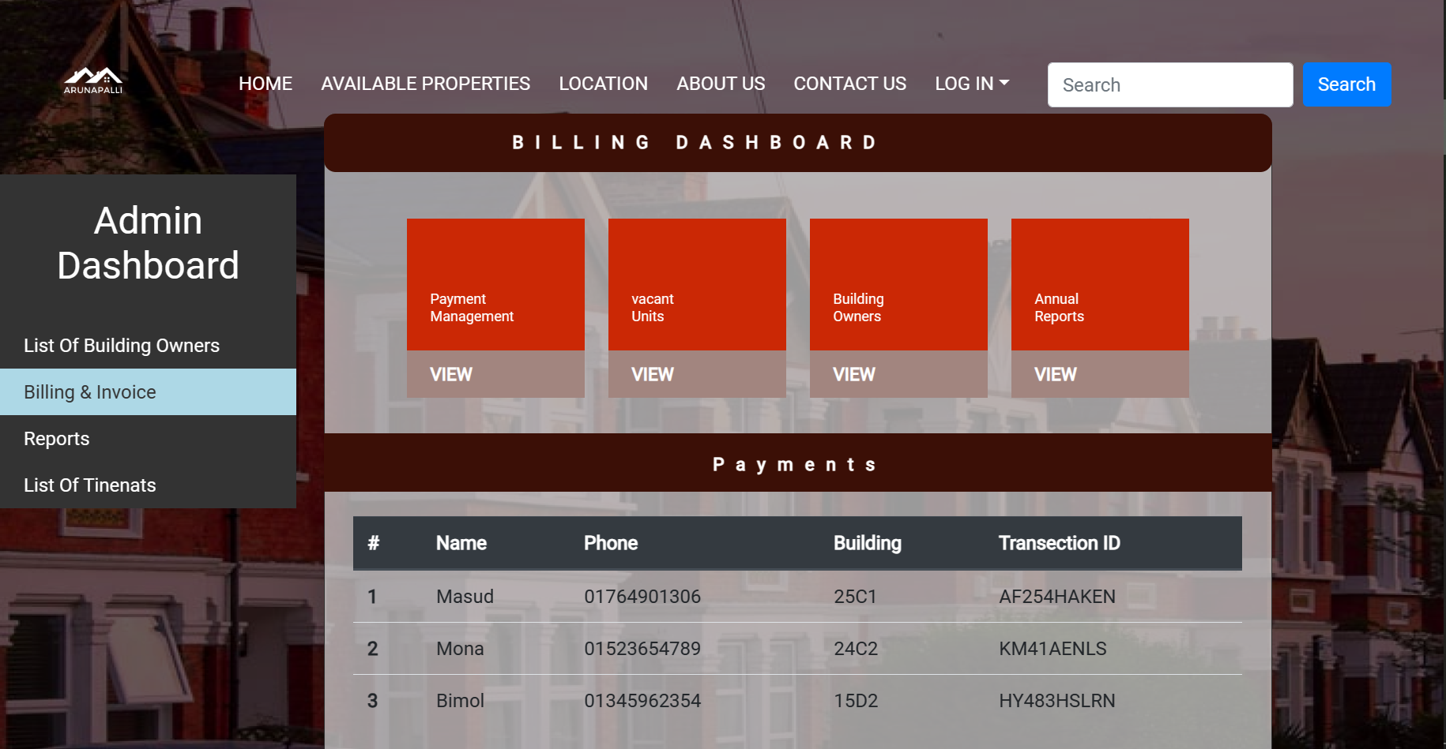
Bill

Slide 8
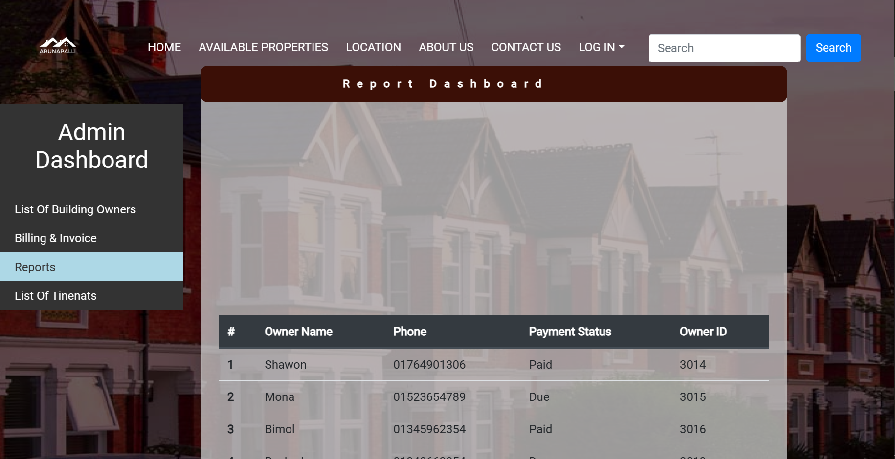
Reports

Slide 9
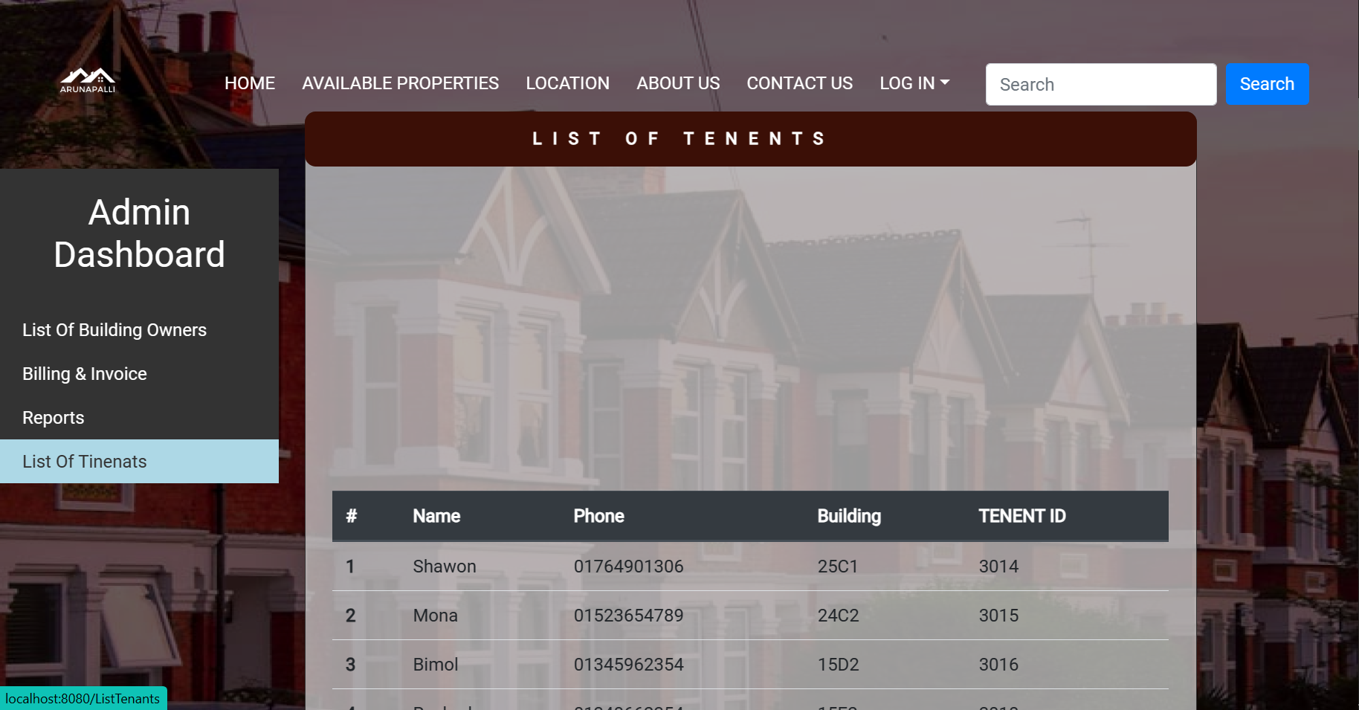
List of Tenants

Slide 10
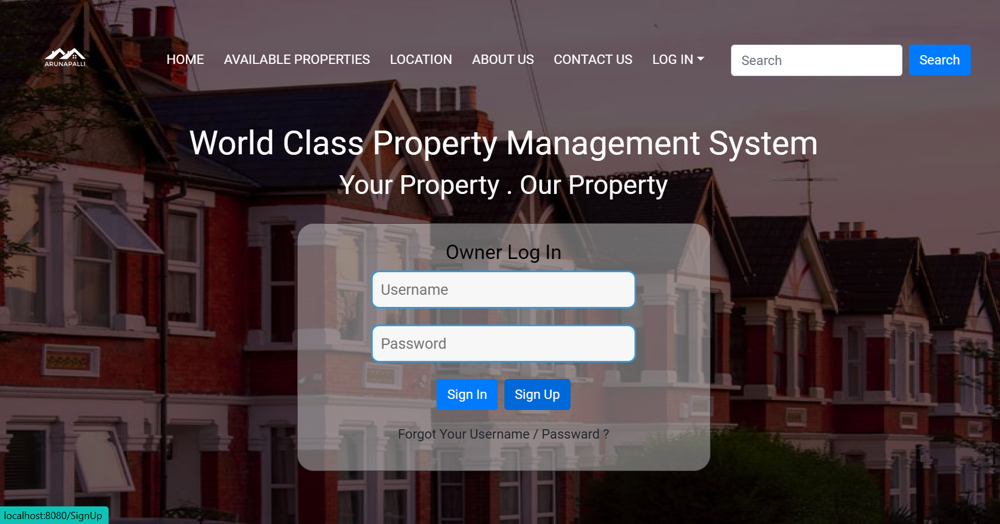
Owner Login

Slide 11
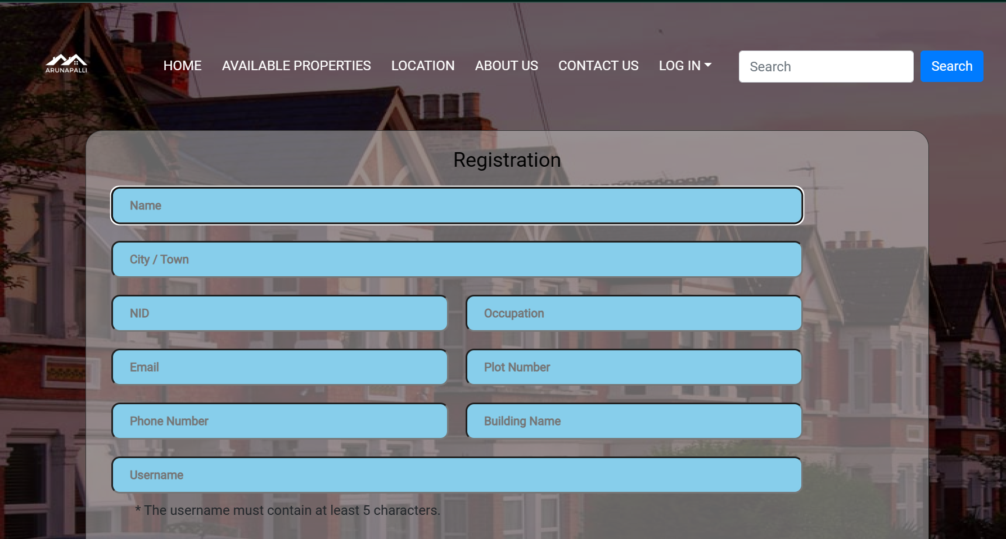
Owner Register

Slide 12
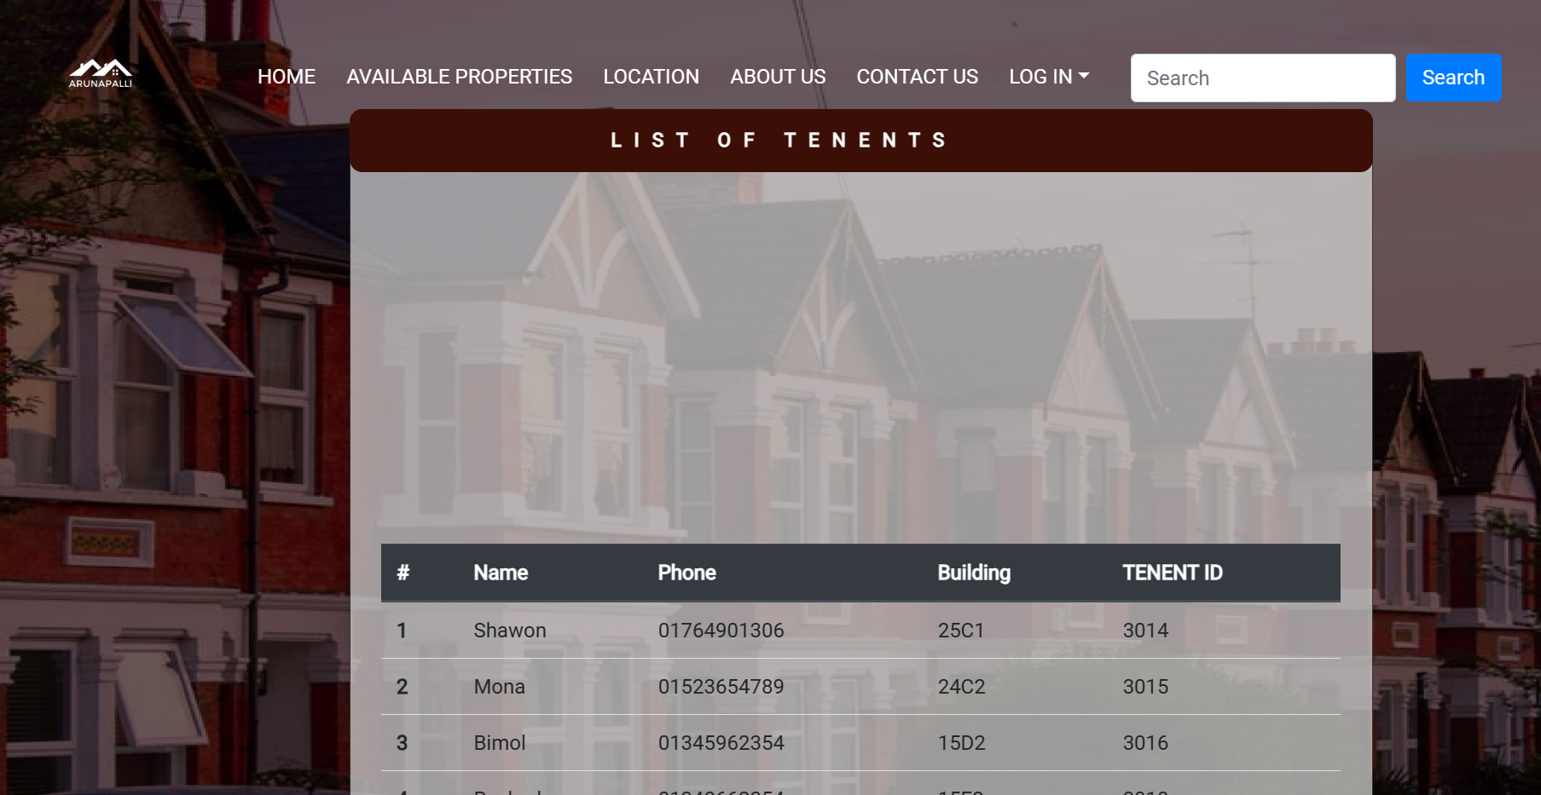
Owner sign in

Slide 13

Tenant log in

Slide 14
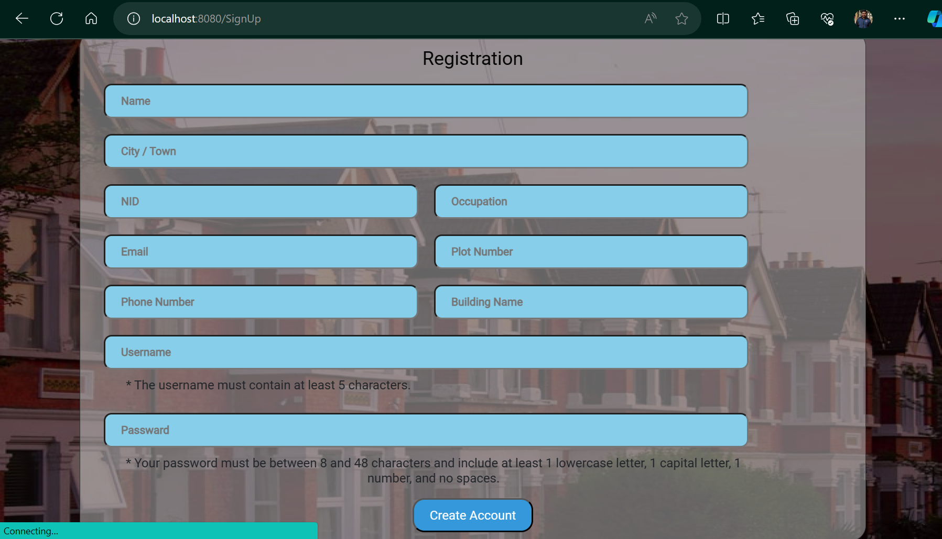
Tenant sign up

Slide 15
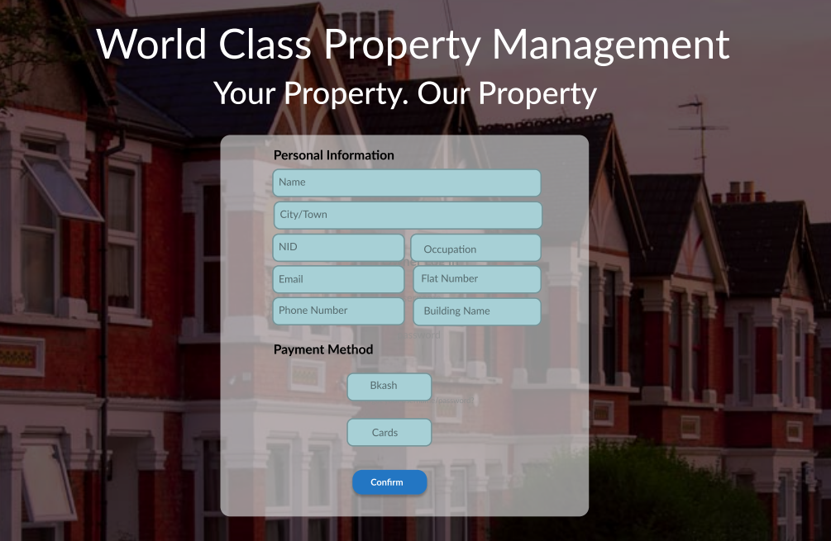
Tenant sign in

Slide 16
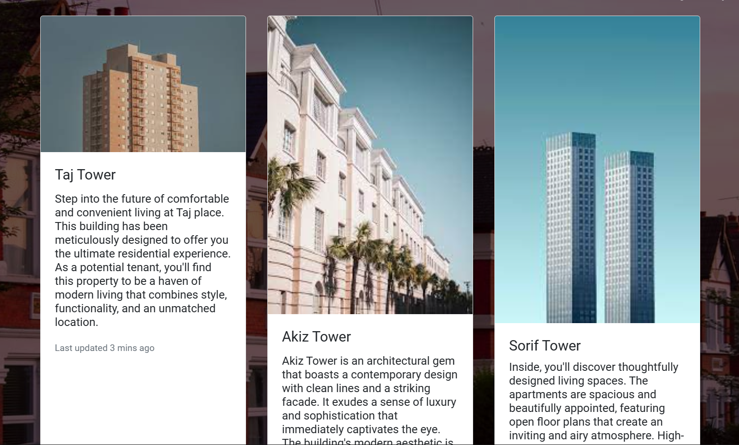
Available properties

Slide 17
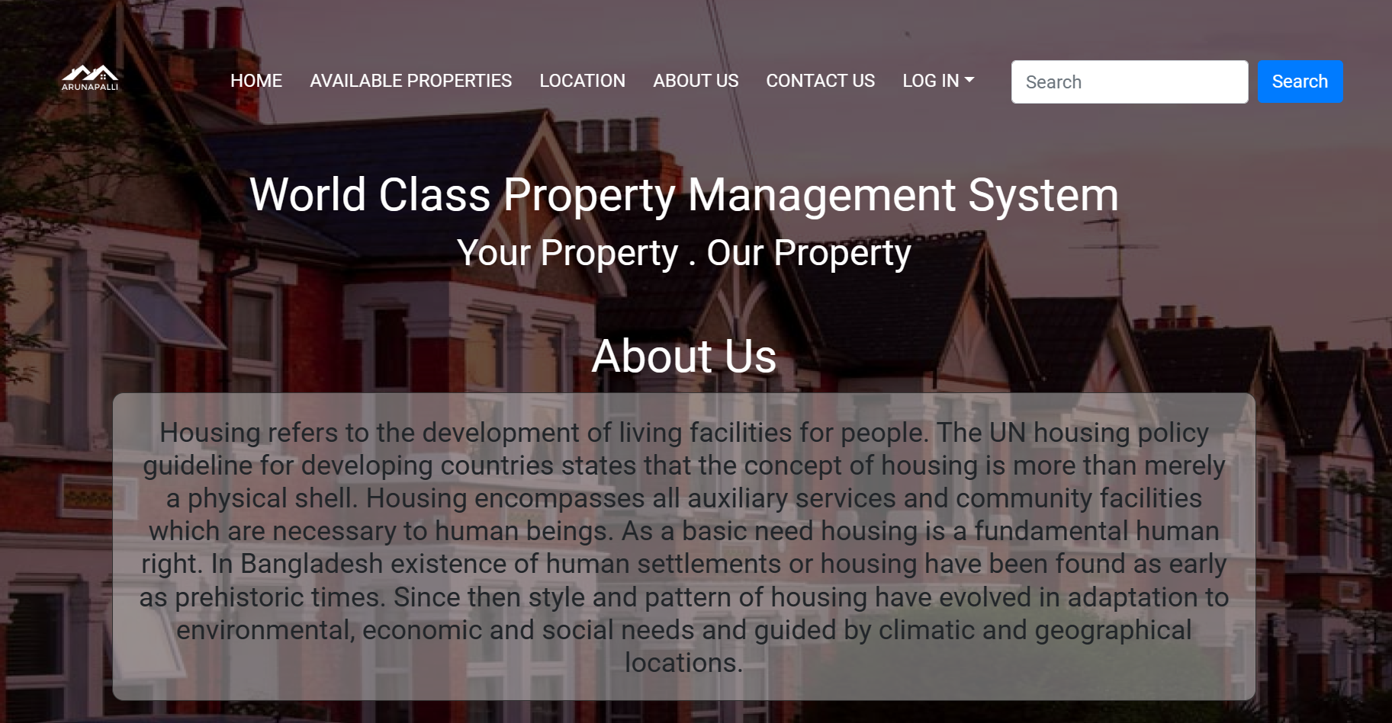
About page

Slide 18
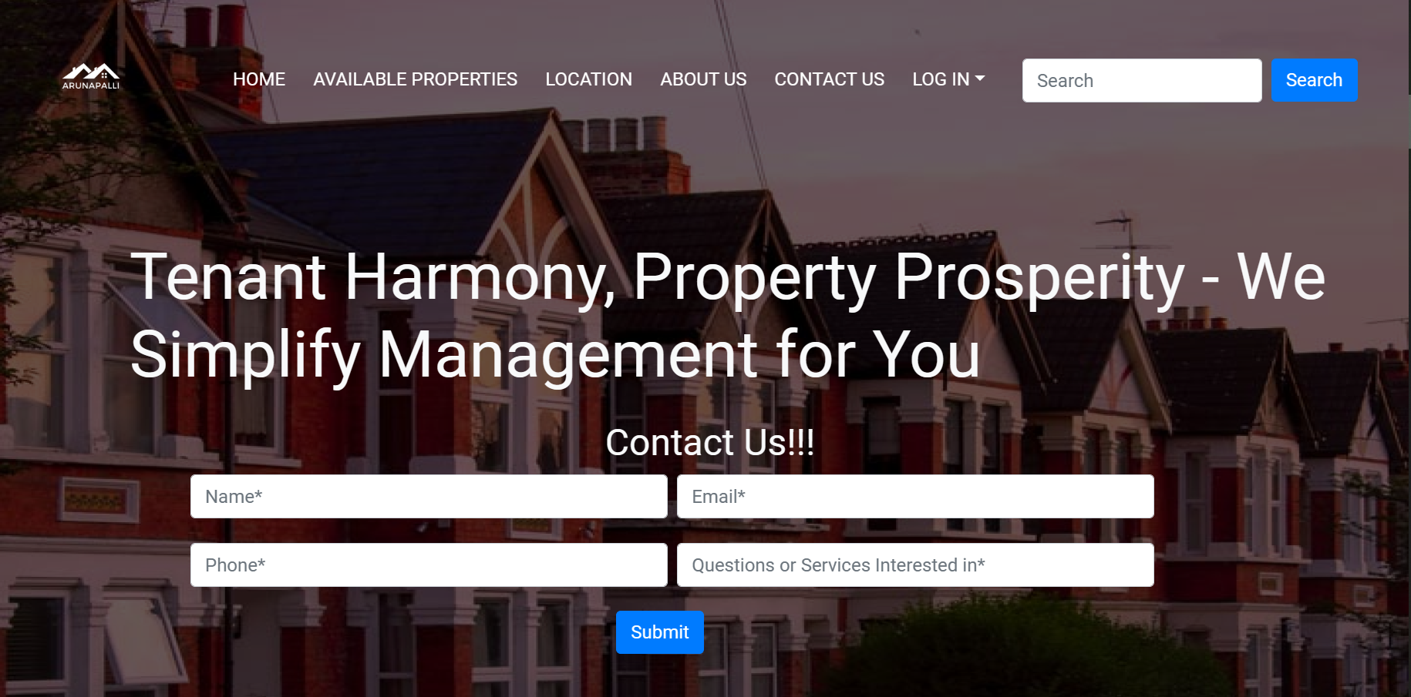
Contact us page

Slide 19
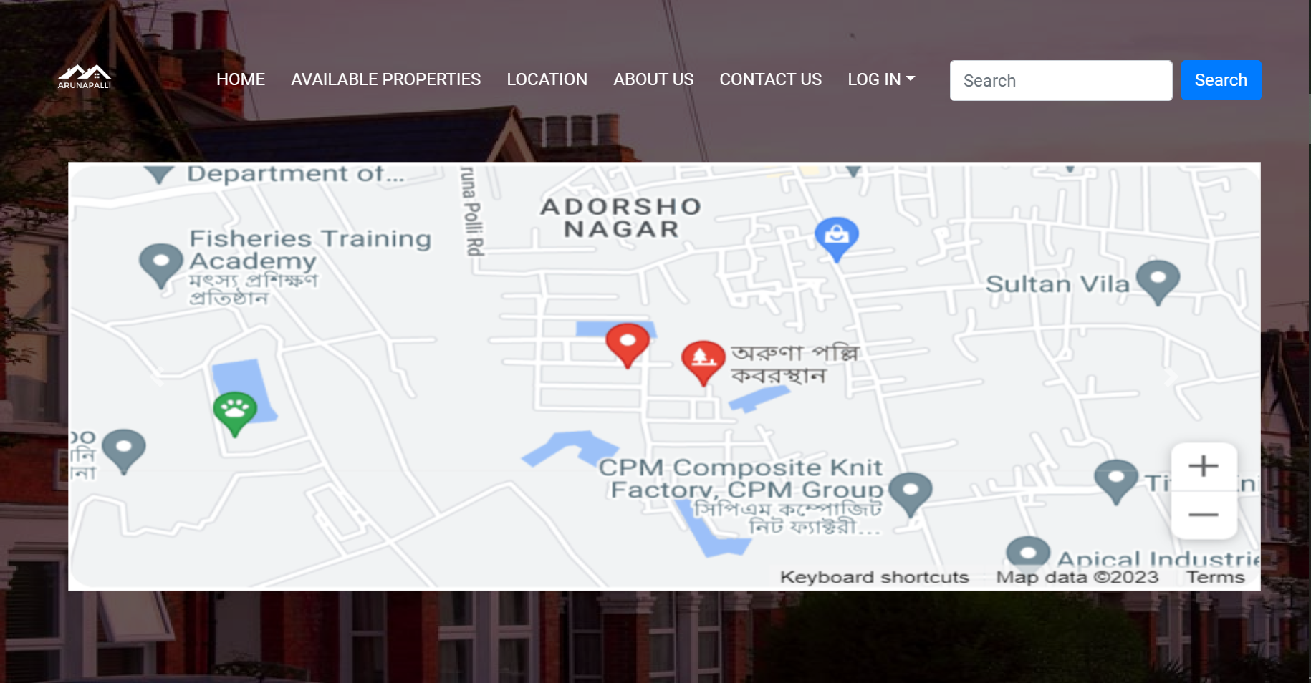
Location page

